Slide 1
Distant Supervision for Relation Extraction without Labeled Data
CSE 5539

Slide 2
A few administrative notes…
I sent an email to the class
Let me know if you’re not able to get it
Logging into Carmen?
Let me know if you continue to have trouble
Email me to reserve a presentation slot if you haven’t already
Email me with project groups
Forum for finding group-mates on Carmen

Slide 3
Extracting relations from text
Company report: “International Business Machines Corporation (IBM or the company) was incorporated in the State of New York on June 16, 1911, as the Computing-Tabulating-Recording Co. (C-T-R)…”
Extracted Complex Relation:
Company-Founding
Company IBM
Location New York
Date June 16, 1911
Original-Name Computing-Tabulating-Recording Co.
But we will focus on the simpler task of extracting relation triples
Founding-year(IBM,1911)
Founding-location(IBM,New York)

Slide 4
Traditional Relation Extraction
Approaches:
Supervised (ACE)
Rule-Based (Hearst Patterns, etc…)
Advantages:
Good in-domain performance
Disadvantages:
Requires lots of human effort for each new relation…
Doesn’t generalize much beyond the domain

Slide 5
Bootstrapping
<Mark Twain, Elmira> Seed tuple
Grep (google) for the environments of the seed tuple
“Mark Twain is buried in Elmira, NY.”
X is buried in Y
“The grave of Mark Twain is in Elmira”
The grave of X is in Y
“Elmira is Mark Twain’s final resting place”
Y is X’s final resting place.
Use those patterns to grep for new tuples
Iterate

Slide 6
Dipre: Extract <author,book> pairs
Brin, Sergei. 1998. Extracting Patterns and Relations from the World Wide Web.
Author | Book
Isaac Asimov | The Robots of Dawn
David Brin | Startide Rising
James Gleick | Chaos: Making a New Science
Charles Dickens | Great Expectations
William Shakespeare | The Comedy of Errors
Start with 5 seeds:
Find Instances:
The Comedy of Errors, by William Shakespeare, was
The Comedy of Errors, by William Shakespeare, is
The Comedy of Errors, one of William Shakespeare's earliest attempts
The Comedy of Errors, one of William Shakespeare's most
Extract patterns (group by middle, take longest common prefix/suffix)
?x , by ?y , ?x , one of ?y ‘s
Now iterate, finding new seeds that match the pattern

Slide 7
Distant Supervision
Snow, Jurafsky, Ng. 2005. Learning syntactic patterns for automatic hypernym discovery. NIPS 17
Fei Wu and Daniel S. Weld. 2007. Autonomously Semantifying Wikipeida. CIKM 2007
Mintz, Bills, Snow, Jurafsky. 2009. Distant supervision for relation extraction without labeled data. ACL09
Combine bootstrapping with supervised learning
Instead of 5 seeds,
Use a large database to get huge # of seed examples
Create lots of features from all these examples
Combine in a supervised classifier

Slide 8
Distant supervision paradigm
Like supervised classification:
Uses a classifier with lots of features
Supervised by detailed hand-created knowledge
Doesn’t require iteratively expanding patterns
Like unsupervised classification:
Uses very large amounts of unlabeled data
Not sensitive to genre issues in training corpus

Slide 9
Distantly supervised learning of relation extraction patterns
For each relation
For each tuple in big database
Find sentences in large corpus with both entities
Extract frequent features (parse, words, etc)
Train supervised classifier using thousands of patterns
Born-In
1
<Edwin Hubble, Marshfield>
<Albert Einstein, Ulm>
2
3
Hubble was born in Marshfield
Einstein, born (1879), Ulm
Hubble’s birthplace in Marshfield
4
PER was born in LOC
PER, born (XXXX), LOC
PER’s birthplace in LOC
5
P(born-in | f₁,f₂,f₃,…,f₇₀₀₀₀)

Slide 10
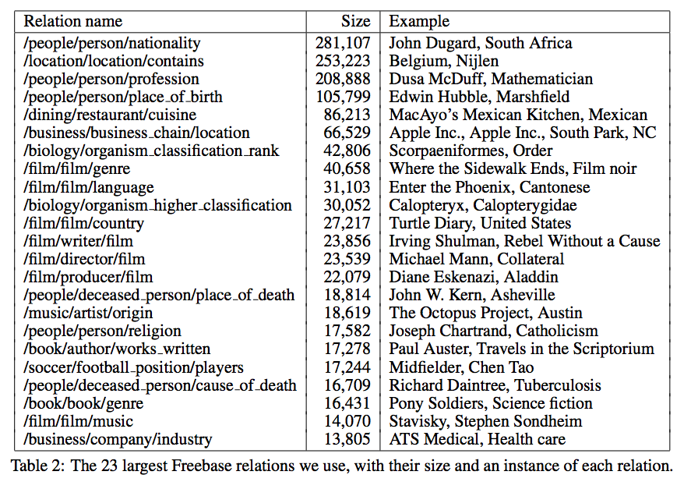

Slide 11
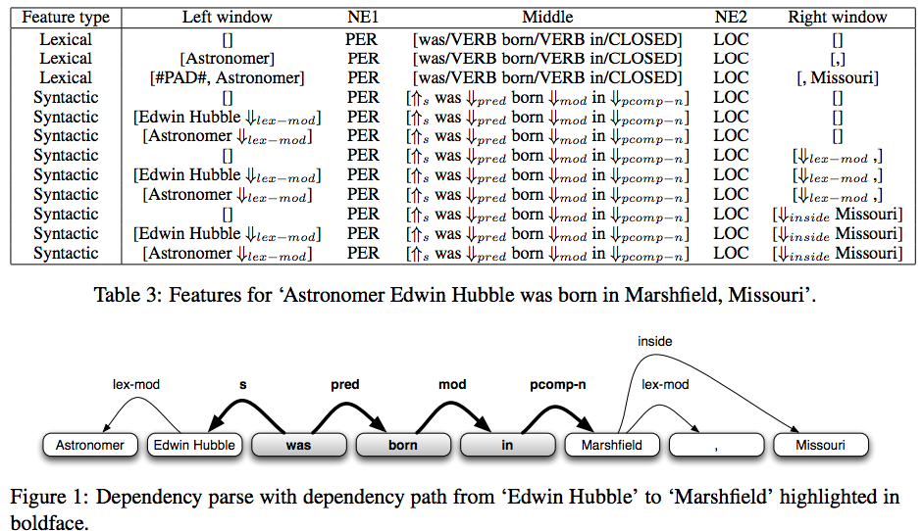

Slide 12
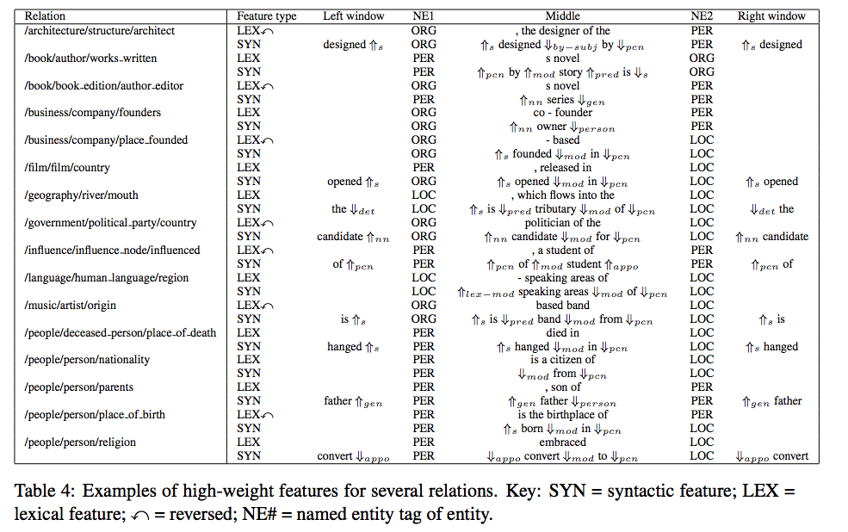

Slide 13
Automatic Evaluation
Hold out facts from freebase
Evaluate precision and recall
Problems:
Extractions often missing from Freebase
Marked as precision errors
These are the extractions we really care about!
New facts, not contained in Freebase
Notes:
OK, so we also did an automatic evaluation, which has been used in a bunch of the previous work.
The idea is to test how well our model can predict held-out facts in Freebase
There are a number of problems with this evaluation.
Facts extracted by our model are often correct, but missing from Freebase, in which case they are marked as precision errors.
In my opinion, these are really the facts we should really care about the most: the whole point of this exercise should be to extract new facts not already in the database!

Slide 14
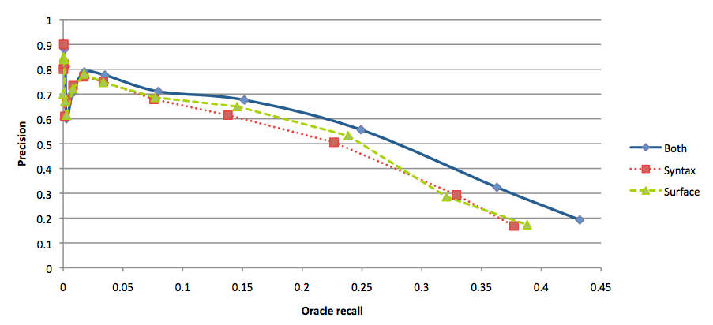
Automatic Evaluation

Slide 15
Automatic Evaluation: Discussion
Correct predictions will be missing form DB
Underestimates precision
This evaluation is biased
Systems which make predictions for more frequent entity pairs will do better.
Hard constraints => explicitly trained to predict facts already in Freebase
[Riedel et. al. 2013]
Notes:
Like I mentioned correct extractions are often missing from the database, so this evaluation is underestimating precision.
This is true for all the models, but I think the bigger problem is that this evaluation is biased towards systems that make predictions for more frequent entities which are likely to appear in Freebase.
Also, I’d like to point out that the system trained using hard constraints is explicitly tuned to extract only those facts in Freebase, whereas our system which is modeling missing data is more likely to predict facts missing from freebase, but which are mentioned in the text.

Slide 16
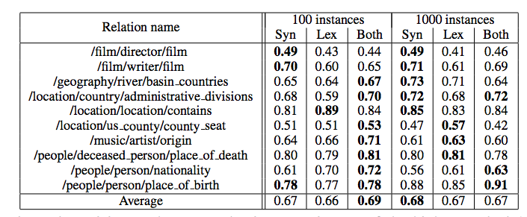
Human Evaluation

